Slide 1
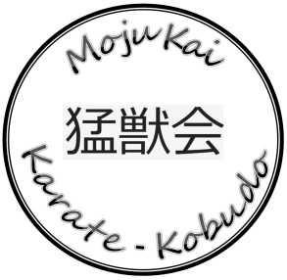
MojuKai Karate-Kobudo
Renshi Lennis Darby
mojukaikarate@gmail.com 334-475-3899
After-School Program Schedule
Monday – Friday 3:00 - 3:30 Pick Up from School, Travel to Dojo
3:30 - 3:45 Arrival at Dojo and Snack
3:45 - 5:00 Homework or Arts/Team building; change to gi on class days
5:30 Dismissal from Class…
Mondays, Wednesdays and Fridays 5:00 - 5:30 Class Session
Tuesdays and Thursdays 3:45 – 5:30 Extended Time for Homework, projects or other positive activities
ONLY people on the approved “Pick-up List” will be allowed to get children from the dojo.

