Slide 1
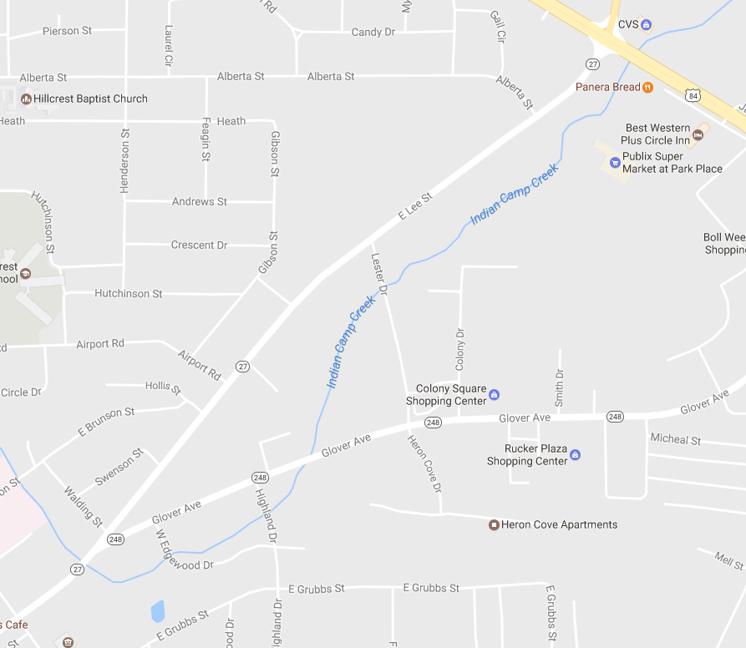
MojuKai Karate
Enterprise
Rec Center

